Slide 1
CS422 Database systems
Query Optimization
Data-Intensive Applications and Systems (DIAS) Laboratory École Polytechnique Fédérale de Lausanne
“Man plans, and God laughs” – Yiddish proverb
Some slides adapted from:
Andy Pavlo
CS-322

Slide 2
Today’s overview
Query Optimization How to increase performance by wisely choosing the order and implementation of the operators?

Slide 3
Today’s overview
Introduction to query optimization
Relational algebra equivalences
Optimizers based on heuristics – INGRES
Optimizers based on heuristics & cost - SYSTEM R
Cost & selectivity estimation
Principle of optimality
Multi-query optimization

Slide 4
Query Optimization
For a given query, find an execution plan with the lowest “cost”.
select S.sname from S, T, C where S.sid=T.sid and T.cid=C.cid and C.cname=’CS101’;

Slide 5
Query Optimization
The part of a DBMS that is the hardest to implement well.
This is (mostly) what you pay for!
No optimizer truly produces the “optimal” plan → Too expensive to consider all plans (NP-complete)! → Impossible to get the accurate cost of a plan without executing it!
Optimizers make a huge difference in terms of
Performance
Scalability
Database capabilities

Slide 6
Decisions to be taken
Order of operations
Particularly: relative order of joins
Implementation for each operation
E.g., hash joins, nested loop joins, sort-merge joins…
Access methods
E.g., scan, use of an index
Bad decisions can have a huge impact! E.g.
Use of a join algorithm
Pushing down selections (that make indexes useless)
Notes:
Pushing down selections is not always a good idea → sometimes they will prohibit us to use use index-lookup join algorithms

Slide 7
Input/output of query optimizer
Input: An AST representing an SQL query
SELECT S.sname FROM Supplier S, Supply U WHERE S.scity='Seattle' AND S.sstate='WA’ AND S.sno = U.sno AND U.pno = 2
Output: A full physical plan → translatable to code
Logical plan (extracted from AST)
Physical plan

Slide 8
Classic architecture
Optimizer
Cost
estimates
SQL Query
Parser
AST
Logical
Plan
Physical
Plan
Notes:
Query arrives from an external application (or a user). It enters into the parser. The parser (e.g., something build by using yacc) will extract an AST.
This AST will be pushed into the optimizer, to extract one or more logical query plans. These plans will then also be converted to physical plans, which will describe exactly when and how each operator will be executed. Physical plans are decided based on cost estimates for each operator. This optimization and generation of the logical plan may even lead to a feedback phase, a back-and-forth between the logical and physical plan, until a good physical plan is produced. Then, the optimizer will push the best plan (with the minimum cost) to the query engine for actual execution.

Slide 9
Classic architecture – Alternative view
Notes:
For completeness: in terms of internal components, some papers and books split the optimizer into two sub-components. The first one is the planner, which will produce the logical plan, and the second one is the optimizer, which will construct the physical plan. In practice, the boundaries between the planner and the optimizer are rather artificial.

Slide 10
Relational Algebra Equivalences
Key concept in optimization: Equivalences
Two relational algebra expressions are said to be equivalent if on every legal database instance the two expressions generate the same set of tuples.
All roads lead to Rome. But some of them are more efficient!

Slide 11
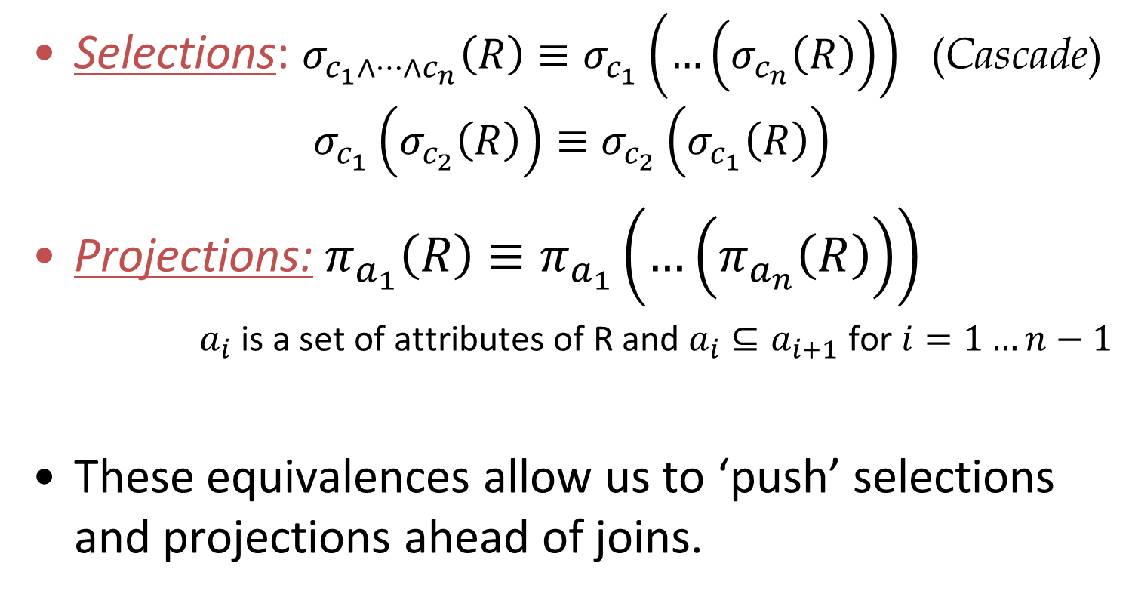
Relational Algebra Equivalences
(Commute)
(Cascade)
Notes:
Selections:
Cascade: We can nest selections
Commute: We can change the order of selections
Projections: decompose a projection to sub-projections, or merge different sub-projections to a single projection

Slide 12
Examples …
σ_{age=18 & rating>5} (Sailors)
↔ σ_{age=18} (σ_{rating>5} (Sailors))
↔ σ_{rating>5} (σ_{age=18} (Sailors))
π_{age,rating} (Sailors) ↔ π_{age} (π_{rating} (Sailors)) (??)
π_{age,rating} (Sailors) ↔ π_{age,rating} (π_{age,rating,sid} (Sailors))
Notes:
1) useful if we already have an index on one of the two (e.g., on rating). Then we can use the index to prune the tuples. ALSO, if we don’t have an index, we can get the Left-hand side – faster
2) This won’t work because at the right-hand side age does not pass from the inner projection
3) Useful when we have ‘nested’ projections (i.e., nested queries) to reduce cost.

Slide 13
Another Equivalence
A projection commutes with a selection that only uses attributes retained by the projection
π_{age, rating, sid} (σ_{age<18 & rating>5} (Sailors))
↔ σ_{age<18 & rating>5} (π_{age, rating, sid} (Sailors))
Notes:
11
This is useful because it can drastically reduce memory requirements. We can push projections (extended with all the used attributes) just over
the data → if we need to materialize the results, require less memory because the size of the projected tuples will be smaller.

Slide 14
Equivalences Involving Joins
R ⨝ (S ⨝ T) (R ⨝ S) ⨝ T
(Associative)
(R ⨝ S) (S ⨝ R)
(Commutative)
These equivalences allow us to choose different join orders
Notes:
10
Commutative: for most join algorithms, it is important to decide which is the outer and which is the inner relation.

Slide 15
Mixing Joins with Selections & Projections
Converting selection + cross-product to join
Selection on just attributes of S commutes with R S
We can also “push down” projections
σ_{S.sid = R.sid} (Sailors x Reserves)
↔ Sailors _{S.sid = R.sid} Reserves
σ_{S.age<18} (Sailors _{S.sid = R.sid} Reserves)
↔ (σ_{S.age<18} (Sailors)) _{S.sid = R.sid} Reserves
CAREFUL!
Not always wise
π_{S.sname} (Sailors _{S.sid = R.sid} Reserves)
↔ π_{S.sname} (π_{sname,sid}(Sailors) _{S.sid = R.sid} π_{sid}(Reserves))
Notes:
11
Which query does the first expression represent? SELECT FROM R INNER JOIN S, which is identical with SELECT FROM R,S WHERE R.sid=S.sid. If the optimizer didn’t have this equivalence it would require to execute a cross product!
Important to reduce the number of intermediary results. This is generally recommended.
Need to keep sid in the projection, otherwise join will not be defined!
For (2), is it possible that pushing selection inside join is BAD for performance (i.e., the right-hand equivalent is worse)? What would happen if, e.g., I had two indexes on sailors, one on sid and another on age. If I push the selection below the join, then I cannot use the index on sid for the join → cannot use index-based join algorithms. Instead, I could just keep the selection outside the join.

Slide 16
An example
Assumption:
S: 16000 tuples T: 256000 tuples C: 1600 tuples
First attempt takes > 2000 years
select S.sname from S, T, C where S.sid=T.sid and T.cid=C.cid and C.cname=’CS101’;
Using cross products!
for each tuple c of C on disk do for each tuple s of S on disk do
for each tuple t of T on disk do if the condition on (s, t, c) holds
output s.sname;
Notes:
Simple 3-way join and a filter
Naïve approach: nested loop cross product, filter inside the cross product
Assume avg seek time to fetch a page 2.5 ms
Assume each relation has 5 attributes
Assume 50 tuples/page
Assume that S join T on sid results each tuple of S matches with 16 tuples of T (i.e., full relation)
Assume that C join T on sid results each tuple of C matches with 160 tuples of T (i.e., full relation)
Assume projections happen in a pipelined fashion
S: 16000 tuples -> 320 pages
T: 256000 tuples -> 5120 pages
C: 1600 tuples -> 32 pages
-> Super-Worst scenarion - awful developer:
The cartegian product of fetching a page for each tuple (1 seek per tuple):
#tuples(C) * #tuples(S) * #tuples(T) = 1600 * 256000 * 16000 = 6553600000000 I/Os
6553600000000*2.5 = 16384000000 s = 519.5 years
-> Very-Bad scenario - awful developer v2:
The cartegian product but reading pages not tuples (1 seek per page).
#pages(C) * #pages(S) * #pages(T) = 32 * 5120 * 320 = 52428800 I/Os
52428800 * 2.5 = 131072 s = 36 hours

Slide 17
An example
Assumption:
S: 16000 tuples T: 256000 tuples C: 1600 tuples
Use joins instead of cross product & push down projection → 70 seconds
select S.sname from S, T, C where S.sid=T.sid and T.cid=C.cid and C.cname=’CS101’;
Notes:
Assume avg seek time to fetch a page 2.5 ms
Assume each relation has 5 attributes
Assume 50 tuples/page
Assume that S join T on sid results each tuple of S matches with 16 tuples of T (i.e., full relation)
Assume that C join T on sid results each tuple of C matches with 160 tuples of T (i.e., full relation)
Assume projections happen in a pipelined fashion
-> Using Block Nested Loops and pushing down projection:
Block nested loop join cost = #pages(Outer) + #pages(Inner)*#pages(Outer)/BlockSize
CostJoinS-T = 320 + (5120*320)/10 = 164160 I/Os
JoinResultS-T = 256000 tuples with 10 attributes (25 tuples/page) = 10240 pages
Project (pick 2 out of the 10 attributes) 2/10*JoinResultS-T = 1/5 * 10240 = 2048 pages
CostJoinResult-C = 32 + (32*2048)/10 = 6586 I/Os
Total: CostJoinS-T + CostJoinResult-C = 170746 I/Os
6890202 * 2.5 = 426.865 s = 7 minutes

Slide 18
An example
Assumption:
S: 16000 tuples T: 256000 tuples C: 1600 tuples
Push down selection and reorder joins → 0.35 seconds!
select S.sname from S, T, C where S.sid=T.sid and T.cid=C.cid and C.cname=’CS101’;
Notes:
Even better if we push selection within join, because then we can reduce the input of the very first join → reduce all intermediary results!
Assume avg seek time to fetch a page 2.5 ms
Assume each relation has 5 attributes
Assume 50 tuples/page
Assume that S join T on sid results each tuple of S matches with 16 tuples of T (i.e., full relation)
Assume that C join T on sid results each tuple of C matches with 160 tuples of T (i.e., full relation)
Assume projections happen in a pipelined fashion
-> Push down selection & re-order joins
assume selectivity of C.cname='CS101' is 1%
CostSelectC = #pages(C) = 32 pages
ResultSelectC = #pages(C)*0.01 = 32*0.01 = 1 page (16 tuples)
ResultProjectC = 0.2*ResultSelectC = 0.2*32*0.01 = 1 page (16 tuples)
JoinCostC-T = 1 + (1*5120)/10 = 513 I/Os
Let's assume that each tuple of 25% of tuples of T match with a tuple of C
ResultJoinC-T = 0.25*256000 = 64000 tuples (25 tuples/page) = 2560 pages
ResultProjectRes = 0.1*2560 = 256 pages
JoinCostResult-S = 256 + (256*320)/10 = 8448 I/Os
Total: CostSelectC + JoinCostC-T + JoinCostResult-S = 8993 I/Os
2261*2.5 = 22.4825 s

Slide 19
Observation
Search Argument Able
Query planning for OLTP queries is easy because they are sargable. → It is usually just picking the best index. → Joins are almost always on foreign key relationships with a small cardinality. → Can be implemented with simple heuristics.
We will focus on OLAP queries in this lecture.

Slide 20
Optimization search strategies
Heuristics
Heuristics + Cost-based Join Order Search
Randomized Algorithms
Stratified Search
Unified Search
TODAY
Not today
Notes:
ORACLE + INGRES in the 70s - Heuristics
SYSTEM R: Heuristics + Cost-based Join Order Search

Slide 21
Heuristic-based optimization
Define static rules that transform logical operators to a physical plan. → Perform most restrictive selections early → Perform all selections before joins → Predicate/Limit/Projection pushdowns → Join ordering based on cardinality
Example: INGRES and Oracle (until mid 1990s)
Stonebraker,
Turing award 2014

Slide 22
Example - INGRES
Developed at UC Berkeley. This ultimately led to Ingres Corp., Sybase, MS SQL Server, Britton-Lee, Wang's PACE.
APPEARS
ARTIST_ID | ALBUM_ID
FK | FK
ARTIST
ALBUM
ID | NAME
Integer, PK | VARCHAR(32)
ID | NAME
Integer, PK | VARCHAR(32) UNIQUE

Slide 23
INGRES optimizer
Retrieve the names of people that appear on Joy's mixtape
SELECT ARTIST.NAME FROM ARTIST, APPEARS, ALBUM
WHERE ARTIST.ID=APPEARS.ARTIST_ID AND APPEARS.ALBUM_ID=ALBUM.ID AND ALBUM.NAME=“Joy's Slag Remix”
APPEARS
ARTIST_ID | ALBUM_ID
FK | FK
ARTIST
ID | NAME
Integer, PK | VARCHAR(32)
ALBUM
ID | NAME
Integer, PK | VARCHAR(32) UNIQUE

Slide 24
INGRES optimizer
Retrieve the names of people that appear on Joy's mixtape
SELECT ARTIST.NAME FROM ARTIST, APPEARS, ALBUM
WHERE ARTIST.ID=APPEARS.ARTIST_ID AND APPEARS.ALBUM_ID=ALBUM.ID AND ALBUM.NAME=“Joy's Slag Remix”
Q1
SELECT ALBUM.ID AS ALBUM_ID INTO TEMP1 FROM ALBUM
WHERE ALBUM.NAME=“Joy's Slag Remix”
Step #1: Decompose into single-variable queries
Q2
SELECT ARTIST.NAME FROM ARTIST, APPEARS, TEMP1
WHERE ARTIST.ID=APPEARS.ARTIST_ID AND APPEARS.ALBUM_ID=TEMP1.ALBUM_ID
APPEARS
ARTIST_ID | ALBUM_ID
FK | FK
ARTIST
ID | NAME
Integer, PK | VARCHAR(32)
ALBUM
ID | NAME
Integer, PK | VARCHAR(32) UNIQUE
Notes:
In INGRES query language (QUEL), correspond to specially constructed tuples that are used for filtering out records from the tables. There is typically a one-to-one mapping between variables and tables, so consider variables=tables. We have 3 variables here: ARTIST, APPEARS and ALBUM.
The first decomposition is simple. For the first query, we just execute the filter on ALBUM. We are storing the result into a temporary table temp1.
Q2 (what remains after Q1) is still not a single-variable query. it depends on both ARTIST and APPEARS. It also depends on the results of TEMP1, but we will see shortly how this will be handled.
We can break Q2 using the same approach as before, by first executing the query on appears which has a filter based on the results of Q1, and then executing the query on ARTIST based on the result of this query.

Slide 25
INGRES optimizer
Retrieve the names of people that appear on Joy's mixtape
SELECT ARTIST.NAME FROM ARTIST, APPEARS, ALBUM
WHERE ARTIST.ID=APPEARS.ARTIST_ID AND APPEARS.ALBUM_ID=ALBUM.ID AND ALBUM.NAME=“Joy's Slag Remix”
Q1
SELECT ALBUM.ID AS ALBUM_ID INTO TEMP1 FROM ALBUM
WHERE ALBUM.NAME=“Joy's Slag Remix”
Q3
Step #1: Decompose into single-variable queries
SELECT APPEARS.ARTIST_ID INTO TEMP2 FROM APPEARS, TEMP1
WHERE APPEARS.ALBUM_ID=TEMP1.ALBUM_ID
APPEARS
ARTIST_ID | ALBUM_ID
FK | FK
Q4
ARTIST
ID | NAME
Integer, PK | VARCHAR(32)
SELECT ARTIST.NAME FROM ARTIST, TEMP2
WHERE ARTIST.ARTIST_ID=TEMP2.ARTIST_ID
ALBUM
ID | NAME
Integer, PK | VARCHAR(32) UNIQUE
Notes:
Q3 retrieves the results from Q1, and Q4 retrieves the results from Q3.
Now, all three queries are single-variable queries. They are also using temporary tables TEMP1 and TEMP2 but this does not constiute a problem.

Slide 26
INGRES optimizer
Retrieve the names of people that appear on Joy's mixtape
SELECT ARTIST.NAME FROM ARTIST, APPEARS, ALBUM
WHERE ARTIST.ID=APPEARS.ARTIST_ID AND APPEARS.ALBUM_ID=ALBUM.ID AND ALBUM.NAME=“Joy's Slag Remix”
Q1
ALBUM_ID
9999
Q3
Step #1: Decompose into single-variable queries
Step #2: Substitute the values from Q1→Q3→Q4
SELECT APPEARS.ARTIST_ID INTO TEMP2 FROM APPEARS, TEMP1
WHERE APPEARS.ALBUM_ID=TEMP1.ALBUM_ID
9999
Q4
SELECT ARTIST.NAME FROM ARTIST, TEMP2
WHERE ARTIST.ARTIST_ID=TEMP2.ARTIST_ID
Notes:
At the second step INGRES will start query execution, and substitution. First, Q1 will be executed. Then, Q3 by substituting TEMP1.ALBUM_ID with Q1 results.

Slide 27
INGRES optimizer
Retrieve the names of people that appear on Joy's mixtape
SELECT ARTIST.NAME FROM ARTIST, APPEARS, ALBUM
WHERE ARTIST.ID=APPEARS.ARTIST_ID AND APPEARS.ALBUM_ID=ALBUM.ID AND ALBUM.NAME=“Joy's Slag Remix”
Q1
ALBUM_ID
9999
Q3
Step #1: Decompose into single-variable queries
Step #2: Substitute the values from Q1→Q3→Q4
ARTIST_ID
123
456
Q4
SELECT ARTIST.NAME FROM ARTIST, TEMP2
WHERE ARTIST.ARTIST_ID=TEMP2.ARTIST_ID
123
NAME
George

Slide 28
INGRES optimizer
Retrieve the names of people that appear on Joy's mixtape
SELECT ARTIST.NAME FROM ARTIST, APPEARS, ALBUM
WHERE ARTIST.ID=APPEARS.ARTIST_ID AND APPEARS.ALBUM_ID=ALBUM.ID AND ALBUM.NAME=“Joy's Slag Remix”
Q1
ALBUM_ID
9999
Q3
Step #1: Decompose into single-variable queries
Step #2: Substitute the values from Q1→Q3→Q4
ARTIST_ID
123
456
Q4
SELECT ARTIST.NAME FROM ARTIST, TEMP2
WHERE ARTIST.ARTIST_ID=TEMP2.ARTIST_ID
456
NAME
George
NAME
John

Slide 29
Heuristic-based optimization
We are judging the optimizer based on today’s database complexity. How about 1975?
Advantages: → Easy to implement and debug. → Works reasonably well and is fast for simple queries & small tables.
Disadvantages: → Doesn’t truly handle joins. → Join ordering based only on cardinalities. → Naïve, nearly impossible to generate good plans when operators have complex interdependencies.
Notes:
Disadvantages
cannot generate good plans for complex queries, because complex queries are not handled as a single query. They are broken down to smaller sub-queries. BUT, need to understand that when INGRES was proposed, there was no real need for complex queries. Typical table size was in the hundreds→ we could do this. Hardware was anyway quite primitive compared to today → parallelism not possible. For the capabilities and reqs back then, a few simple rules and this substitution were sufficient to generate decent logical plans which would largely translate one-to-one
Join ordering is only based on cardinality/number of records. How about seek time? IO bandwidth? How about the physical properties of the data (in memory, already sorted or indexed, etc.)?
Fully ignoring interdependencies between the operators. E.g., order of results produced by intermediary operators + pipelining possibilities are ignored.
Remember: ORACLE was using this optimizer successfully until the mid 90s. So heuristic based optimization was successful

Slide 30
Heuristics + cost-based optimizer
Use static rules to perform initial optimization.
Then use dynamic programming to determine the best join order for tables. → Bottom-up planning using a divide-and-conquer search method → The first cost-based query optimizer
Example: System R, early IBM DB2, most open- source DBMSs
Pat Selinger
IBM Fellow &
Paradata
Notes:
A more advanced optimizer proposed by Selinger in 1979! Combines heuristics and cost based optimization.
SYSTEM R was never commercialized but it SHAPED today’s database field. Even today, most DBs are using cost-based optimization → ideas that were developed in the 70s.

Slide 31
A small parenthesis
Cost & selectivity
estimation

Slide 32
Cost Estimation
Generate an estimate of the cost of executing a plan for the current state of the database. → Interactions with other work in DBMS → Size of intermediate results → Choices of algorithms, access methods → Resource utilization (CPU, I/O, network) → Data properties (skew, order, placement)
Notes:
Need to account for different factors.

Slide 33
Cost Estimation – brief reminder
Estimate cost for each physical operator
Simplification: Only consider I/O cost, part. number of pages
How valid is this?
Requires specialization to become main-memory-aware
Material of CS322
Details at book chapter “Evaluation of Relational Operators”
Examples
Selection without index, unsorted
Page-Oriented Nested Loop Join

Slide 34
Selection
Selection without index, unsorted
for each record r in R
if (r.age<18)
add r to result
Let’s unveil I/O
Notes:
Access path: table scan. Table not sorted.

Slide 35
Selection
Selection without index, unsorted
I/O Cost: number of read pages
Here we don’t consider #pages written. Why?
Cost will change if
Records are sorted based on the condition attribute
We can utilize an index to filter out some records
We need to materialize the output result
We will also use different physical implementation
for each record r in R
if (r.age<18)
add r to result
for each page p in R
for each record r in p
if (r.age<18)
add r to result
I/O

Slide 36
Page-oriented Nested Loop join
for each record r in R
for each record s in S
if (r.id=s.id)
add <r,s> to result
}
for each page p1 in R
for each page p2 in S
for each record r in p1
for each record s in p2
if (r.id=s.id)
add <r,s> to result
For each tuple in the outer relation R, we scan the entire inner relation S
But use per-page loading!
I/O Cost: #pages of R + #pages of R * #pages of S
How to choose the outer relation to minimize the cost?
Choose order of R, S, s.t. #pages of R < #pages of S
Benefits of this are typically minor
I/O

Slide 37
Selectivity estimates
Required for cost estimation
Output of selection is input of another operator!
⨝
How large
is the output
⨝
T
σ_{bid=100}
σ_{rating>5}
R
S
Notes:
Besides IO cost estimates, we also want to take into account selectivity estimates.

Slide 38
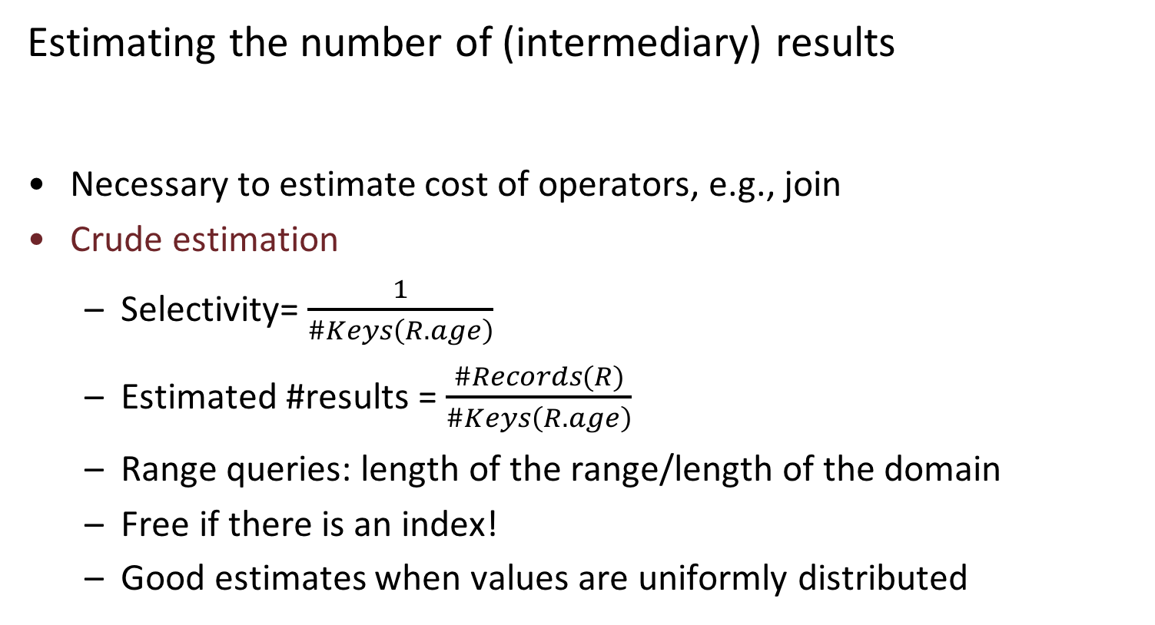
Selectivity estimates
Estimating the number of (intermediary) results
Necessary to estimate cost of operators, e.g., join
Crude estimation
Selectivity= $\frac{1}{\#Keys\left(R.age\right)}$
Estimated #results = $\frac{\#Records(R)}{\#Keys\left(R.age\right)}$
Range queries: length of the range/length of the domain
Free if there is an index!
Good estimates when values are uniformly distributed
SELECT * FROM R WHERE r.age=18
Number of distinct
values
Notes:
These estimates are computed progressively (in some cases, user needs to instruct the db to re-compute them!)
If there is an index, can be read from the index.

Slide 39
Selectivity estimates
Estimating the number of (intermediary) results
Histograms: Equi-width and Equi-depth
Higher cost to build and maintain, but better accuracy.
SELECT * FROM R WHERE r.age=18
Skew somewhere in [20-30]
Skew in 23
Accurate in [40-100]
Very inaccurate
in [40-100]
Notes:
Repeat the same drill as before to estimate the selectivity, but NOW use only the details of the bucket(s) necessary for the query. For example, for r.age=18, we only need to use the count and #keys for the bucket where 18 falls into! → more accurate.
Clearly, both equi-width and equi-depth have their benefits for different distributions. Generally, equi-depth are preferred but they are more expensive to build.

Slide 40
Join cardinality estimates
π_{sid}
Required for cost estimation of each join
Reorder joins so that records are filtered as fast as possible!
How large
is the output
⨝
⨝
T
σ_{bid=100}
σ_{rating>5}
R
S
Notes:
Same approach to estimate the cardinality of a join.
Very important because we can then reorder joins to reduce the number of intermediary results as fast as possible.

Slide 41
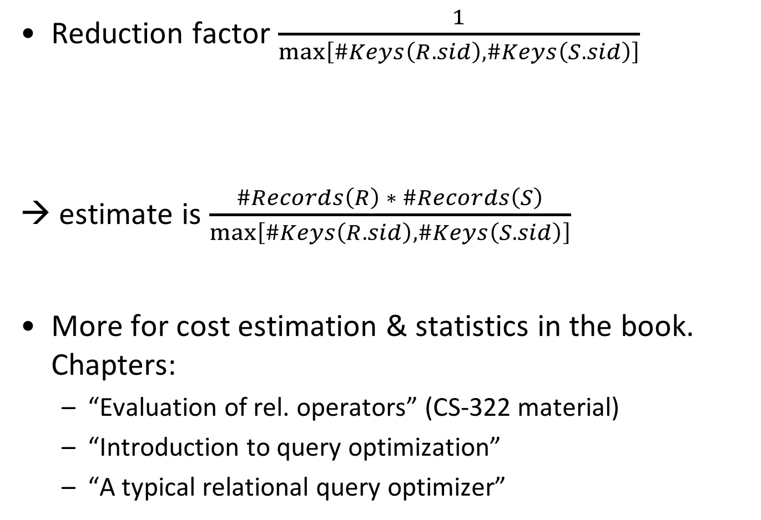
Join cardinality estimates
Reduction factor $\frac{1}{\max\left[\#Keys\left(R.sid\right),\#Keys\left(S.sid\right)\right]}$
→ estimate is $\frac{\#Records\left(R\right) ∗ \#Records\left(S\right)}{\max\left[\#Keys\left(R.sid\right),\#Keys\left(S.sid\right)\right]}$
More for cost estimation & statistics in the book. Chapters:
“Evaluation of rel. operators” (CS-322 material)
“Introduction to query optimization”
“A typical relational query optimizer”
If unknown,
use 10!

Slide 42
Now back to
Selinger’s work
and
SYSTEM R

Slide 43
SYSTEM R Optimizer
IBM SYSTEM R
Seminal project from the 70s
Drastic influence on succeeding dbs!
High-level idea
Iterate over the possible plans
Order of operators, physical implementations of operators, access paths
Estimate cost of each plan
Return the cheapest to the user
Too many plans. Use heuristics
to reduce the search space

Slide 44
SYSTEM R Optimizer
Step 1: Break query up into blocks and generate the logical operators for each block.
Reduces complexity of each plan
Block: No nested queries, exactly one SELECT & FROM, and at most one WHERE, GROUP BY, HAVING
SELECT S.sid, MIN (R.day)
FROM Sailors S, Reserves R, Boats B
WHERE S.sid = R.sid AND R.bid = B.bid AND B.color = ‘red’
AND S.rating = (SELECT MAX (S2.rating) FROM Sailors S2)
GROUP BY S.sid
HAVING COUNT(*)>1
Notes:
Reason to break the query is for reducing the complexity of each individual plan → the number of possible plans. We will be optimizing each block on its own.

Slide 45
SYSTEM R Optimizer
Step 1: Break query up into blocks and generate the logical operators for each block.
Reduces complexity of each plan
Block: No nested queries, exactly one SELECT & FROM, and at most one WHERE, GROUP BY, HAVING
Nested Block:
SELECT MAX (S2.rating) FROM Sailors S2
SELECT S.sid, MIN (R.day)
FROM Sailors S, Reserves R, Boats B
WHERE S.sid = R.sid AND R.bid = B.bid AND B.color = ‘red’
AND S.rating = Reference to Nested Block
GROUP BY S.sid
HAVING COUNT(*)>1
Notes:
.

Slide 46
SYSTEM R Optimizer
Step 1: Break query up into blocks and detect the logical operators in each block.
Step 2: For each individual block:
For each logical operator, consider a set of physical operators & offered access paths.
Iteratively construct a “left-deep” tree that minimizes the estimated amount of work to execute the plan.
Why left-deep?
Notes:
Second step: consider each individual block.
Try to decide on the physical implementation of each operator and on the access path.
Additional heuristics to reduce plan space (besides the blocks):
first decide on the access path, (b) only consider left-deep
Left-deep trees naturally transform to physical plans with pipelining → good, particularly for hardware that was available back in 1980s since it frequently does not require writing the intermediary results to the disk!
Even today, ORACLE has a preference toward left-deep trees.

Slide 47
SYSTEM R Optimizer
Retrieve the names of people that appear on Joy's mixtape
SELECT ARTIST.NAME FROM ARTIST, APPEARS, ALBUM
WHERE ARTIST.ID=APPEARS.ARTIST_ID AND APPEARS.ALBUM_ID=ALBUM.ID AND ALBUM.NAME=“Joy's Slag Remix”
ORDER BY ARTIST.ID
ARTIST: Sequential scan
APPEARS: Sequential scan
ALBUM: Index lookup on name
Step #1: Choose the best access path to each table
APPEARS
ARTIST_ID | ALBUM_ID
FK | FK
ARIST, APPEARS: No index, no predicate in the WHERE clause that could use an index
ARTIST
ID | NAME
Integer, PK | VARCHAR(32)
ALBUM: Index would help (assume it exists)
ALBUM
ID | NAME
Integer, PK | VARCHAR(32) UNIQUE
Notes:
Example with a single-block query.

Slide 48
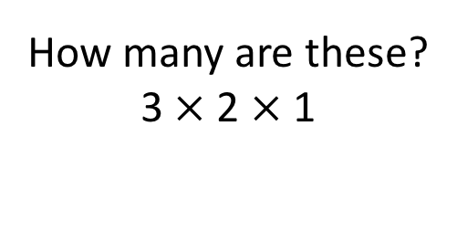
SYSTEM R Optimizer
Retrieve the names of people that appear on Joy's mixtape
SELECT ARTIST.NAME FROM ARTIST, APPEARS, ALBUM
WHERE ARTIST.ID=APPEARS.ARTIST_ID AND APPEARS.ALBUM_ID=ALBUM.ID AND ALBUM.NAME=“Joy's Slag Remix”
ORDER BY ARTIST.ID
ARTIST: Sequential scan
APPEARS: Sequential scan
ALBUM: Index lookup on name
All possible join orders
ARTIST ⨝ APPEARS ⨝ ALBUM APPEARS ⨝ ALBUM ⨝ ARTIST ALBUM ⨝ APPEARS ⨝ ARTIST … … …
Step #1: Choose the best access path to each table
Step #2: Enumerate all possible join orderings for tables
How many are these?
3 $×$2 $×$1

Slide 49
SYSTEM R Optimizer
Retrieve the names of people that appear on Joy's mixtape
SELECT ARTIST.NAME FROM ARTIST, APPEARS, ALBUM
WHERE ARTIST.ID=APPEARS.ARTIST_ID AND APPEARS.ALBUM_ID=ALBUM.ID AND ALBUM.NAME=“Joy's Slag Remix”
ORDER BY ARTIST.ID
ARTIST: Sequential scan
APPEARS: Sequential scan
ALBUM: Index lookup on name
All possible join orders
ARTIST ⨝ APPEARS ⨝ ALBUM APPEARS ⨝ ALBUM ⨝ ARTIST ALBUM ⨝ APPEARS ⨝ ARTIST … … …
Step #1: Choose the best access path to each table
Step #2: Enumerate all possible join orderings for tables
Step #3: Determine the join ordering with the lowest cost

Slide 50
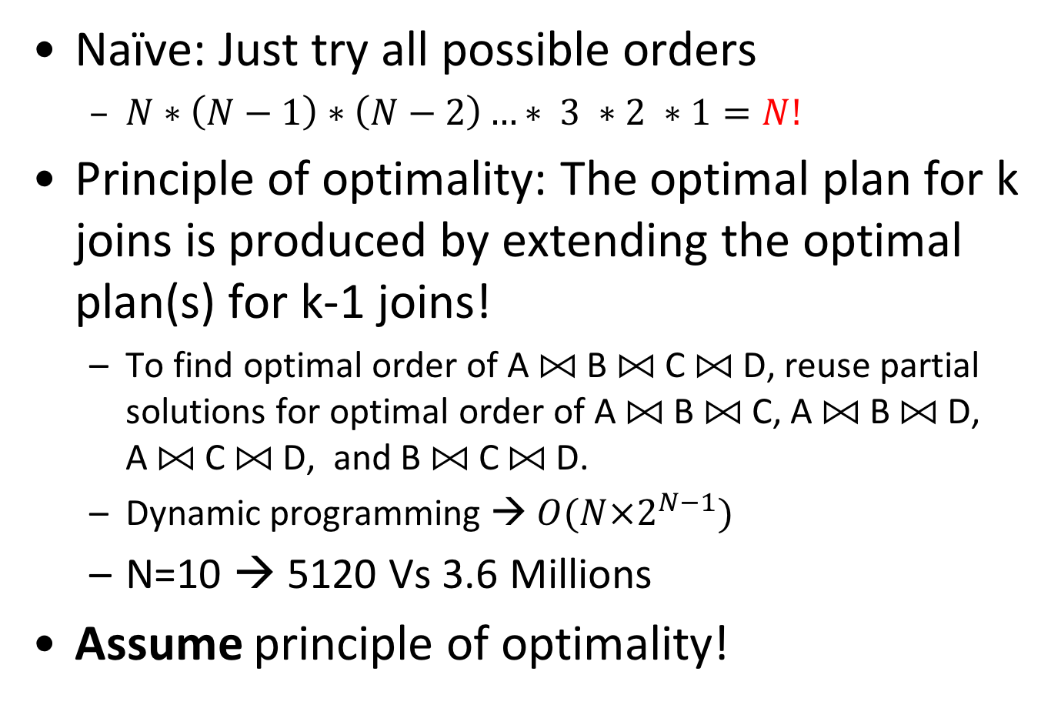
Join ordering
Scales BADLY with #joins N
Naïve: Just try all possible orders
$N∗\left(N−1\right)∗\left(N−2\right)…∗ 3 ∗2 ∗1=N!$
Principle of optimality: The optimal plan for k joins is produced by extending the optimal plan(s) for k-1 joins!
To find optimal order of A ⨝ B ⨝ C ⨝ D, reuse partial solutions for optimal order of A ⨝ B ⨝ C, A ⨝ B ⨝ D, A ⨝ C ⨝ D, and B ⨝ C ⨝ D.
Dynamic programming →$O(N×2^{N−1})$
N=10 → 5120 Vs 3.6 Millions
Assume principle of optimality!
Still expensive but feasible
Notes:
Even though we restricted ourselves to left-deep, still very expensive!

Slide 51
Principle of optimality – Getting A⨝B⨝D
….
A⨝B⨝C⨝D
….
Cost 1=70
A⨝B⨝C
A⨝B⨝D
A⨝C⨝ D
B⨝C⨝ D
A⨝B
A⨝C
A⨝D
B⨝C
B⨝D
C⨝D
A
B
C
D
Notes:
Two ways to get A join B join D. Just pick the best one and consider it fixed

Slide 52
Principle of optimality – Getting A⨝B⨝D
Choose the cheapest path to create A⨝B⨝D, and consider it fixed for higher levels!
….
A⨝B⨝C⨝D
….
Cost 2=100
A⨝B⨝C
A⨝B⨝D
A⨝C⨝ D
B⨝C⨝ D
A⨝B
A⨝C
A⨝D
B⨝C
B⨝D
C⨝D
A
B
C
D
Notes:
Order in join defines the inner-outer table!

Slide 53
Back to our running example…
HashJoin cost=10
SM Join cost=20
NL Join=100
ARTIST⨝APPEARS
ALBUM
ARTIST
APPEARS
ALBUM
ARTIST⨝APPEARS⨝ALBUM
ALBUM⨝APPEARS
ARTIST
HashJoin cost=10
SM Join cost=20
NL Join=100
SELECT ARTIST.NAME FROM ARTIST, APPEARS, ALBUM
WHERE ARTIST.ID=APPEARS.ARTIST_ID AND APPEARS.ALBUM_ID=ALBUM.ID AND ALBUM.NAME=“Joy's Slag Remix”
ORDER BY ARTIST.ID
…

Slide 54
Back to our running example…
HashJoin cost=10
SM Join cost=20
NL Join=100
ARTIST⨝APPEARS
ALBUM
ARTIST
APPEARS
ALBUM
ARTIST⨝APPEARS⨝ALBUM
ALBUM⨝APPEARS
ARTIST
HashJoin cost=10
SM Join cost=20
NL Join=100
SELECT ARTIST.NAME FROM ARTIST, APPEARS, ALBUM
WHERE ARTIST.ID=APPEARS.ARTIST_ID AND APPEARS.ALBUM_ID=ALBUM.ID AND ALBUM.NAME=“Joy's Slag Remix”
ORDER BY ARTIST.ID
…
Notes:
How valid is the principle for optimality? It is AN ASSUMPTION! But it drastically prunes out our space!
Reading list: Read example at section 3 from here: https://web.stanford.edu/class/cs345d-01/rl/chaudhuri98.pdf

Slide 55
Back to our running example…
ARTIST⨝APPEARS
ALBUM
HashJoin cost=35
SM Join cost=55
NL Join=80
HashJoin cost=10
ARTIST
APPEARS
ALBUM
ARTIST⨝APPEARS⨝ALBUM
HashJoin cost=30
SM Join cost=20
NL Join=100
ALBUM⨝APPEARS
ARTIST
HashJoin cost=10
SELECT ARTIST.NAME FROM ARTIST, APPEARS, ALBUM
WHERE ARTIST.ID=APPEARS.ARTIST_ID AND APPEARS.ALBUM_ID=ALBUM.ID AND ALBUM.NAME=“Joy's Slag Remix”
ORDER BY ARTIST.ID
…

Slide 56
Back to our running example…
ARTIST⨝APPEARS
ALBUM
HashJoin cost=35
SM Join cost=55
NL Join=80
HashJoin cost=10
ARTIST
APPEARS
ALBUM
ARTIST⨝APPEARS⨝ALBUM
HashJoin cost=30
SM Join cost=20
NL Join=100
ALBUM⨝APPEARS
ARTIST
HashJoin cost=10
SELECT ARTIST.NAME FROM ARTIST, APPEARS, ALBUM
WHERE ARTIST.ID=APPEARS.ARTIST_ID AND APPEARS.ALBUM_ID=ALBUM.ID AND ALBUM.NAME=“Joy's Slag Remix”
ORDER BY ARTIST.ID
…
Notes:
Interesting orders technique:

Slide 57
Back to our running example…
HashJoin cost=10
ARTIST⨝APPEARS
ALBUM
HashJoin cost=35
ARTIST
APPEARS
ALBUM
ARTIST⨝APPEARS⨝ALBUM
SM Join cost=20
ALBUM⨝APPEARS
ARTIST
HashJoin cost=10
SELECT ARTIST.NAME FROM ARTIST, APPEARS, ALBUM
WHERE ARTIST.ID=APPEARS.ARTIST_ID AND APPEARS.ALBUM_ID=ALBUM.ID AND ALBUM.NAME=“Joy's Slag Remix”
ORDER BY ARTIST.ID
…

Slide 58
Back to our running example…
HashJoin cost=10
ARTIST⨝APPEARS
ALBUM
HashJoin cost=35
SUM=45
ARTIST
APPEARS
ALBUM
ARTIST⨝APPEARS⨝ALBUM
SUM=30
SM Join cost=20
ALBUM⨝APPEARS
ARTIST
HashJoin cost=10
SELECT ARTIST.NAME FROM ARTIST, APPEARS, ALBUM
WHERE ARTIST.ID=APPEARS.ARTIST_ID AND APPEARS.ALBUM_ID=ALBUM.ID AND ALBUM.NAME=“Joy's Slag Remix”
ORDER BY ARTIST.ID
…

Slide 59
Back to our running example…
ARTIST
APPEARS
ALBUM
ARTIST⨝APPEARS⨝ALBUM
SUM=30
ALBUM⨝APPEARS
ARTIST
HashJoin cost=10
SM Join cost=20
Constructed in parallel:
Logical plan (join order)
Physical plan (join implementation)

Slide 60
What did we use?
Logical & Physical statistics
size of each record, #records, #distinct values in column, #data pages, #pages in index, …
Selectivity estimates
Histograms (or other distribution assumptions)
Formulas for selectivity estimates: assumption of independence of distributions!
Formulas to estimate IO costs (possibly also CPU) per operator
Access methods (index or scan), natural orders (e.g., primary key, …)
Order of output data stream
The principle of optimality
Notes:
physical statistics concern the actual storage
Logical statistics concern the records.
Assumption of independence of distributions: Consider, e.g., that we have two selections (age<10 & height >1.80 m). These are typically mutually exclusive. But database doesn’t know this! it will consider selectivity of each of them only! Histograms (1-d) will be used to compute selectivity, and two selectivities will be multiplied!

Slide 61


Slide 62
Is principle of optimality correct?
Principle of optimality may lead to suboptimal plans
E.g., order not considered
Additional cost at the end – avoided by sort merge join!
Weaker principle of optimality
Consider order! A plan is compared with all other plans that produce the same order
Does this ring a bell?
SELECT ARTIST.NAME FROM ARTIST, APPEARS, ALBUM
WHERE ARTIST.ID=APPEARS.ARTIST_ID AND APPEARS.ALBUM_ID=ALBUM.ID AND ALBUM.NAME=“Joy's Slag Remix”
ORDER BY ARTIST.ID

Slide 63
Interesting orders
Attribute has interesting order if it participates in a join predicate, and:
it occurs in the Group By clause
it occurs in the Order By clause
Choose plans that produce the correct order, e.g.,
Sort-merge join instead of NL join
Decide on the outer/inner table order
Later generalized to include any physical properties not common across the plans!
Will cause an
additional sorting
Notes:
Physical properties, e.g,. where it data stored, whether it is partitioned or not

Slide 64
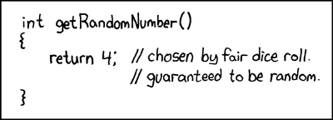
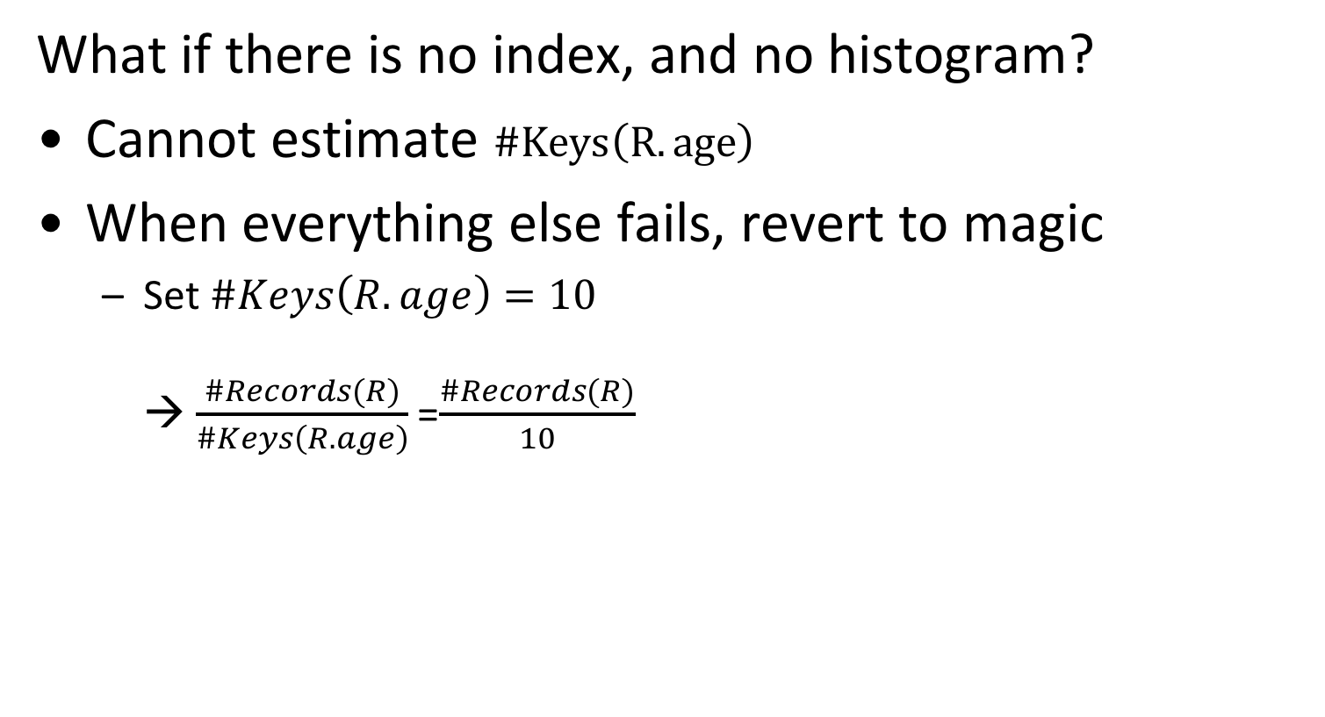
Selectivity estimates, revisited
What if there is no index, and no histogram?
Cannot estimate $\#Keys\left(R.age\right)$
When everything else fails, revert to magic
Set $\#Keys\left(R.age\right)=10$ → $\frac{\#Records(R)}{\#Keys\left(R.age\right)}$ =$\frac{\#Records(R)}{10}$
Source: https://xkcd.com/221/

Slide 65
Summary of System R optimizer
Both heuristics and cost
Efficient and usually derives reasonable plans
Relies on
Principle of optimality
Interesting orders
System R was never commercialized, but was hugely influential!

Slide 66
Heuristics + cost-based optimizer
Advantages:
→ Usually finds a reasonable plan without having to perform an exhaustive search.
→ Order of results also considered! Disadvantages:
→ Depends on heuristics.
→ Does not consider complex operator interdependencies & resource usage. → Space exploration only considers joins. → Left-deep join trees are not always optimal (particularly for modern hardware)
Notes:
Problems:
At the heuristics part, we need to apply all these heuristics (similar to INGRES, e.g., pushing down predicates and selections, checking equivalences…) BEFORE being able to even consider join orderings. If these heuristics work well, then great. If not, then too bad!
What if two queries are executed at the same time and the first one occupies a lot of memory?
Space exploration only considers joins. All other choices decided by the heuristics
Left deep joins used to reduce space of the plan. They were reasonable many years ago, and they were preferred in order to reduce IO (pipelining) but are they reasonable now?

Slide 67
Additional optimization opportunities
Optimization Granularity
Optimization Timing
Plan Stability

Slide 68
Optimization granularity
Choice #1: Single Query → Much smaller search space. → DBMS cannot reuse results across queries. → In order to account for resource contention, the cost model must account for what is currently running.
Choice #2: Multiple Queries → More efficient if there are many similar queries. → Search space is much larger. → Useful for scan sharing.

Slide 69
Optimization timing
Choice #1: Static Optimization → Select the best plan prior to execution. → Plan quality is dependent on cost model accuracy. → Can amortize over executions with prepared stmts.
Choice #2: Dynamic Optimization → Select operator plans on-the-fly as queries execute. → Will have to reoptimize for multiple executions. → Difficult to implement/debug (non-deterministic)
Choice #3: Hybrid Optimization → Compile using a static algorithm. → If the error in estimate > threshold, reoptimize

Slide 70
Plan stability
Choice #1: Hints → Allow the DBA to provide hints to the optimizer.
Choice #2: Fixed Optimizer Versions → Set the optimizer version number and migrate queries one-by-one to the new optimizer.
Choice #3: Backwards-Compatible Plans → Save query plan from old version and provide it to the new DBMS.

Slide 71
Fixed Optimizer Versions
Question: I just upgraded to Oracle 10g and I'm seeing very bad SQL performance. I had to set optimizer_features_enable=9.0.5. What can I do to fix Oracle10g upgrade & migration performance tuning problems?
Answer: Oracle has improved the cost-based Oracle optimizer in 9.0.5 and again in 10g, so you need to take a close look at your environmental parameter settings (init.ora parms) and your optimizer statistics. I have complete directions in my book "Oracle Tuning - The Definitive Reference", but here are some notes. See also Oracle tips for 10g migration. and Oracle 11g upgrade performance problems.
There is even a dedicated command to make this easy, i.e., business as usual!
SQL> ALTER SYSTEM SET OPTIMIZER_FEATURES_ENABLE=’9.0.5';
It happens to the best of us!
Notes:
A small parenthesis on the impact of the optimizer. Updating the version of the optimizer can be a pain!

Slide 72
Optimization for multiple queries
Running multiple OLAP queries concurrently can saturate the I/O bandwidth (disk, memory)
If they access different parts of a table at the same time, buffer manager won’t help.
Solution: SCAN SHARING
Explicitly changing the loading order of pages!

Slide 73
Scan sharing
Queries are able to reuse data retrieved from storage or operator computations.
Allow multiple queries to attach themselves to a single cursor that scans a table. → Queries do not have to be exactly the same. → Can also share intermediate results.

Slide 74
Disk-based scan sharing
Q₂ needs to perform a scan, Q₁ already doing it → DBMS will attach the Q₂ to Q₁’s scan cursor. → The DBMS keeps track of where the second query joined with the first so that it can finish the scan when it reaches the end of the data structure.
Fully supported in IBM DB2 and Microsoft SQL. Oracle only supports cursor sharing for identical queries.

Slide 75
Disk-based scan sharing
DISK
Q₁: SELECT SUM(val) FROM A
Q₂: SELECT AVG(val) FROM A
Q₂
Q₁
Page 1
Q₂
Q₁
Page 2
Buffer pool
Q₂ already checked the rest!
Page 3
Q₂
Q₁
Page 1
Page 4
Page 2
Q₂
Q₁
Page 4
Page 2
Page 5
Q₂
Page 5
Page 3
Q₁
Page 1

Slide 76
Disk-based scan sharing
Drastically reduces I/O when queries can share cursor
Queries share cursor when they have the same access path
Can a nested-loop join and a selection share a cursor?
What if the common table is the outer table of the join?

Slide 77
In-memory scan sharing
Nuanced: Limited cache space (&convoy phenomenon)
In practice: IBM BLINK -- Query accelerator for IBM DB2 with support for explicit scan sharing.
Each worker thread will execute a separate table scan operation.
A dedicated reader thread feeds blocks of tuples to the worker threads. → Load a block of tuples in the cache and share it among multiple queries. → All worker threads need to acknowledge they are finished with the current block before the reader can move on to the next one.
Notes:
“Avoid going back to memory” -> sacrifice a bit in terms of latency

Slide 78
Summary
Query optimizer has a huge impact on DBMS performance, scalability, capabilities for OLAP queries
Challenges
Cost estimation
Efficient space exploration (both physical & logical plans)
Heuristics & cost-based optimization
Particularly important for joins!
Multi-query optimization

